Slide 1




Introduction part II
How to do it?
Lokesh
@LokeshBio
@LokeshBio

Slide 2
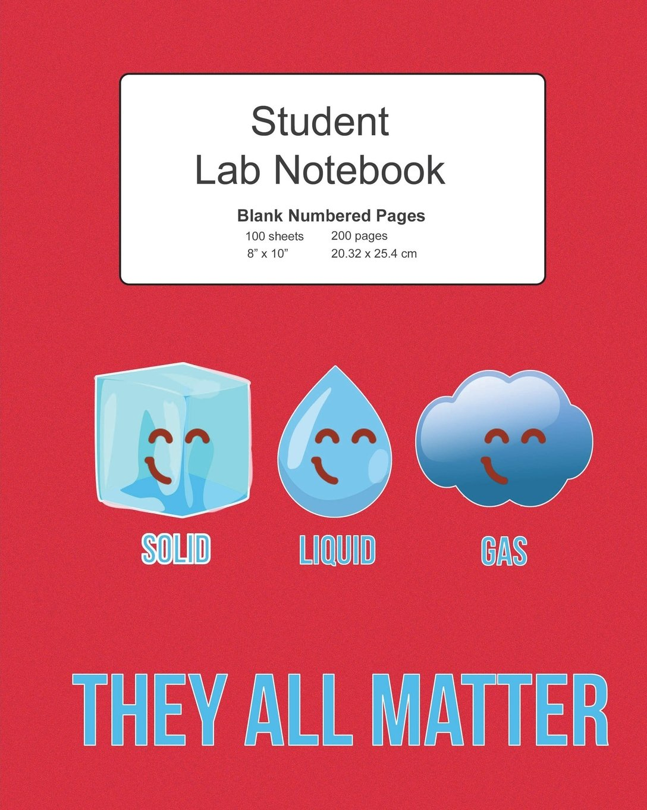

How to do it?

Slide 3
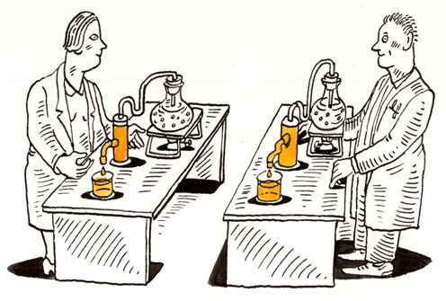
Reproducible Research

Slide 4
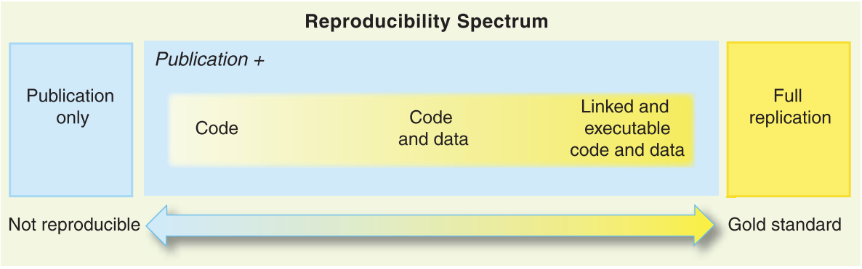
Reproducibility
“Reproducible research in Computational Science”, Peng et al. (2011) Science

Slide 5
Culture of reproducibility
“Computational science has led to exciting new developments, but the nature of the work has exposed limitations in our ability to evaluate published findings”
“Reproducibility has the potential to serve as a minimum standard for judging scientific claims when full independent replication of a study is not possible”
“In cases in which questionable results are obtained, reproducibility is critical to tracking down the “bugs” of computational science”
“Ultimately, developing a culture of reproducibility in which it currently does not exist will require time and sustained effort from the scientific community”
“The scientific community’s “culture of replication” has served to quickly weed out spurious claims”
“Reproducible research in Computational Science”, Peng et al. (2011) Science

Slide 6
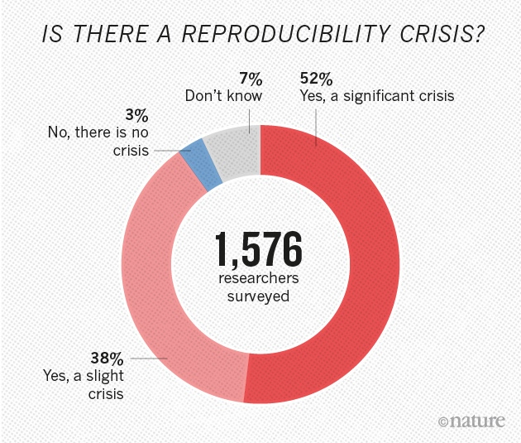
The Reproducibility “Crisis”
“More than 70% of researchers have tried and failed to reproduce another scientist's experiments, and more than half have failed to reproduce their own experiments.”
“1,500 Scientists Lift the Lid on Reproducibility.” Baker, Monya. (2016) Nature

Slide 7
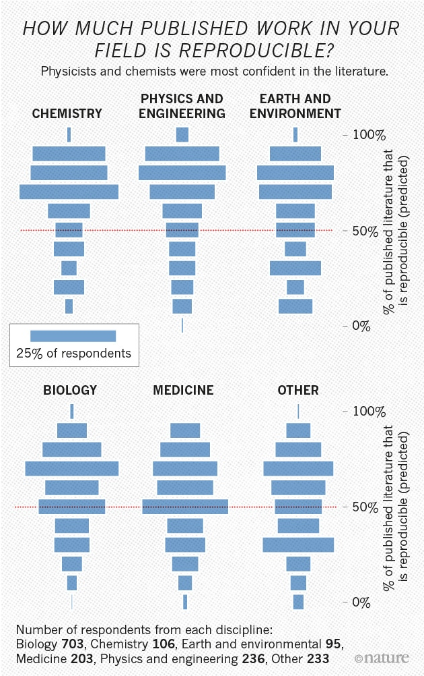
The Reproducibility “Crisis”
“1,500 Scientists Lift the Lid on Reproducibility.” Baker, Monya. (2016) Nature

Slide 8
Reproducibility vs Replicability
Reproduce: create identical conditions to a previous result and come to the identical result
Replicate: repeat a previously described experiment with new material or data
Depending on who you ask, these definitions are reversed!

Slide 9
What is Reproducibility?
Reproduce: create identical conditions to a previous result and come to the identical result
For Bioinformatics, this means:
apply the same methodology (ideally same code) to
the same data and obtain
the same result
If code is not available, must first reimplement the method

Slide 10
What is Replicability?
Replicate: repeat a previously described experiment with new material or data
For Bioinformatics, this means:
apply the same methodology to new data or
a new methodology to the same data and arrive at
the same biological conclusion
If code is not available, must first reimplement the method

Slide 11
Definitions for Bioinformatics
Reproduce = show methodology was applied correctly
Replicate = test whether the scientific result is “true”
Reimplement = turn verbal description of method into a new reification of the method
Reapply = run existing code on existing or new data
In summary: Reproducibility and replicability are about results Reimplementation and reapplication are about methods

Slide 12
Four Main Components of Analysis
Data
Code
Computational Environment (with tools)
Presentation

Slide 13
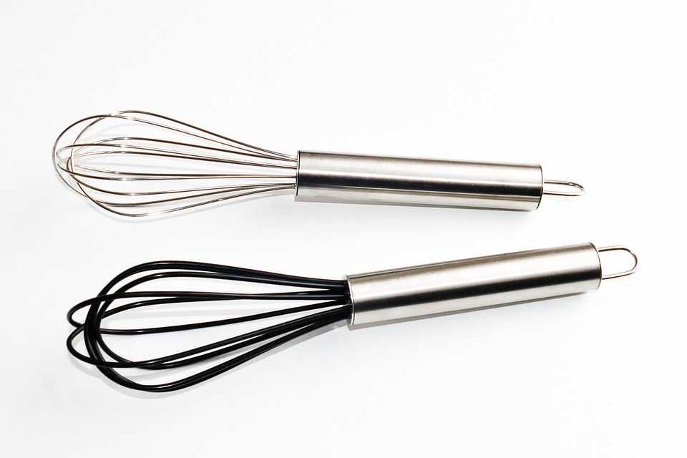


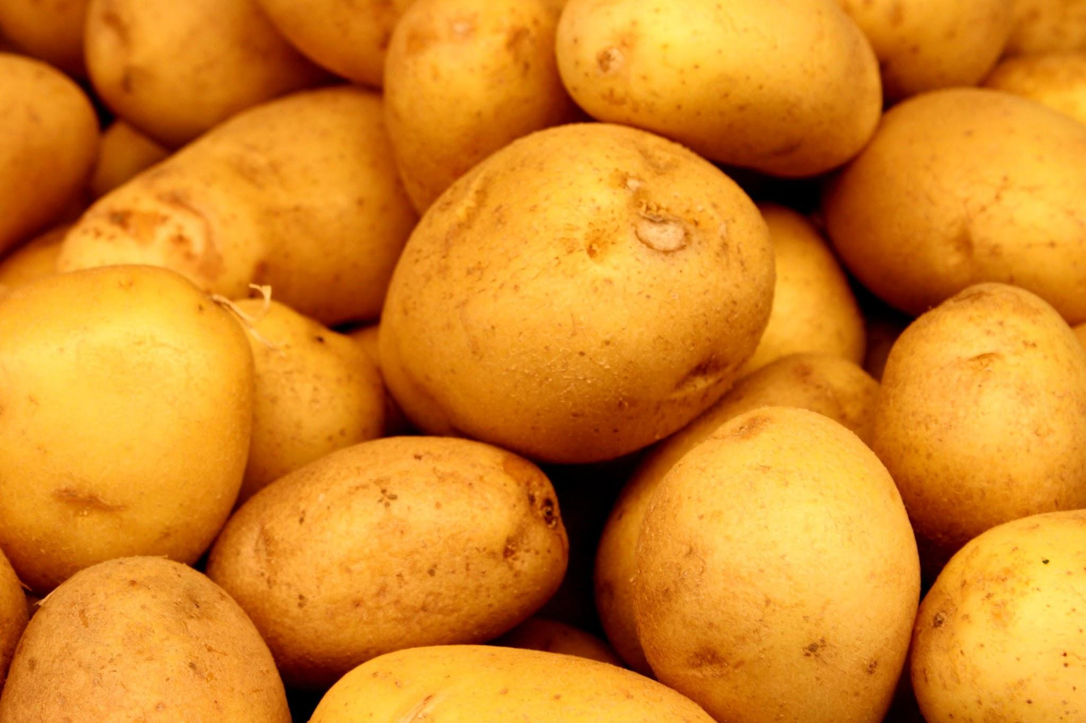

Kitchen Analogy
Tools
Code
+
Environment
Data
Presentation

Slide 14
Data

Slide 15
Three types of data
Source data
short read datasets, microarrays, etc
Support data
Reference genomes, gene annotations, etc
Transformed data
Alignments, gene counts, etc.

Slide 16
Data maintenance
Source Data
E.g. Raw untrimmed reads directly from sequencer
Should be available in a public database like NCBI (SRA)
Should not be part of the workflow
Support Data
Data used to condense, process, annotate, and interpret source data
Most support data are maintained in persistent repositories with consistent formats
Keep track of the version or date of the database/repository it has been downloaded
Transformed Data
Derived from source(+support) data
Usually what we use to interpret our results
Code is a recipe for creating transformed data from source data
Could be made available in a public database

Slide 17
Code

Slide 18

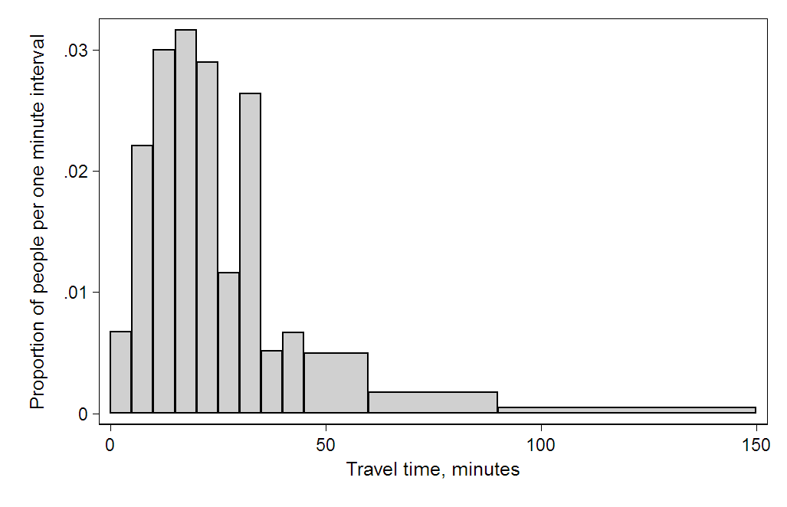

Code is a recipe
Describes how data is transformed from one form to another
Combination of analysis code and glue code
FASTQ
BAM
Counts
Interpretable plots
Countsmatrix
DE genes

Slide 19
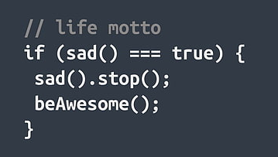
Important coding practice
COMMENTS
Always comment on “what” the code is trying to do and sometimes “how” it is trying to do
Variable names
Simple but explanatory variable names
Versions…..

Slide 20
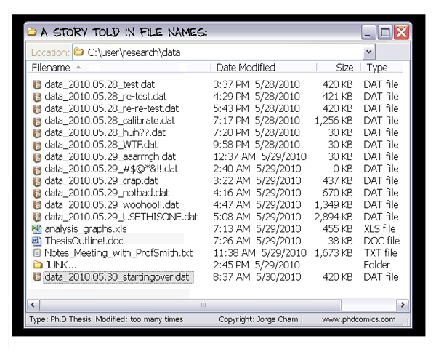
Versions of code

Slide 21
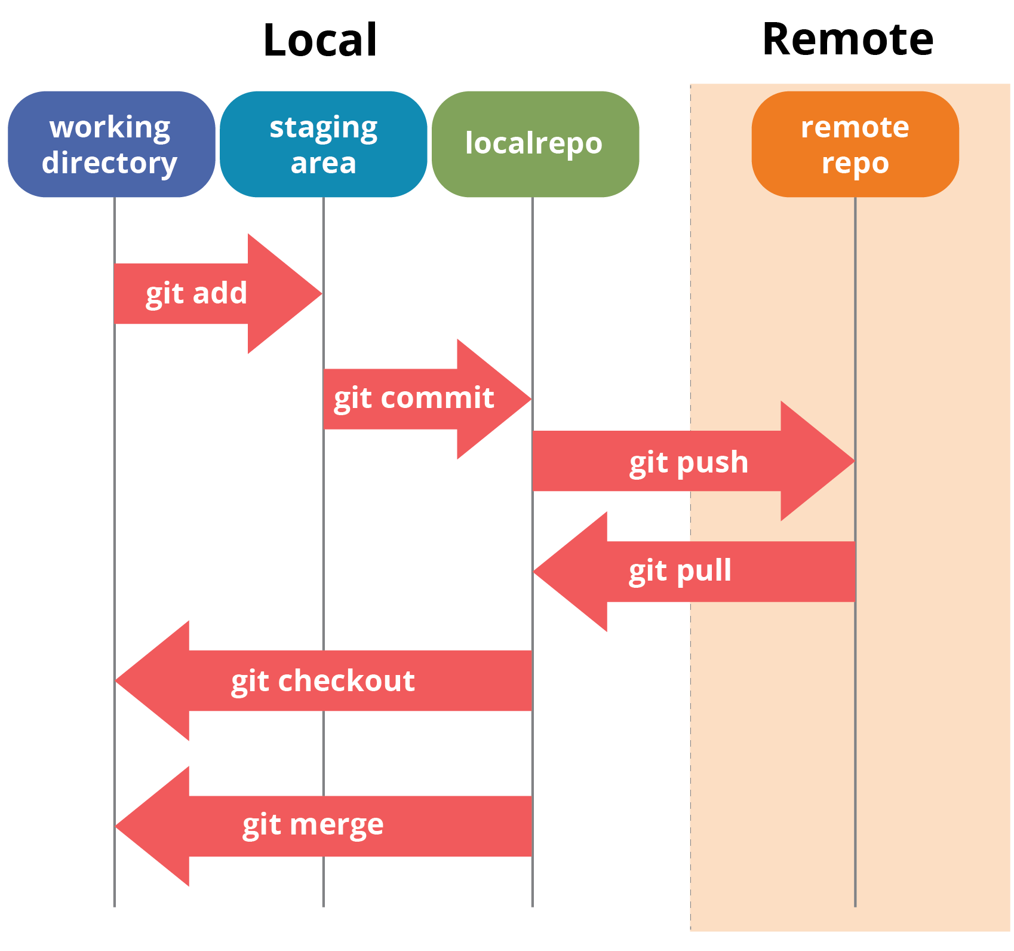

Version control systems (VCS)

Slide 22


VCS platforms
Seamless backup of code
Simplified sharing and collaboration
Public dissemination of analysis code upon publication

Slide 23


Workflows
FASTQ
BAM
Counts
Interpretable plots
Countsmatrix
DE genes
Python-based
Groovy-based

Slide 24
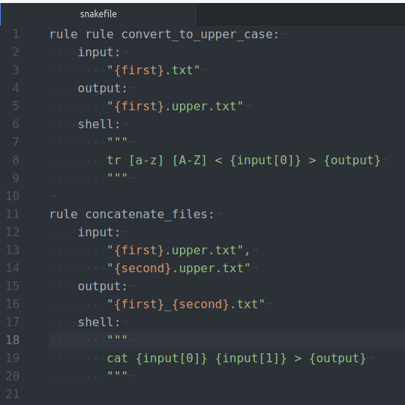
Simple Snakemake
Let’s assume you have two files “a.txt” and “b.txt”
In step 1: You would like to convert the text files to uppercase “a.upper.txt” and “b.upper.txt” respectively
In step 2: You would like to combine/concatenate the two files into one called “a_b.txt”
The following would be the example of a “snakefile” that contains all the “rules”
A simple command will automatically do the entire process:
$snakemake a_b.txt

Slide 25
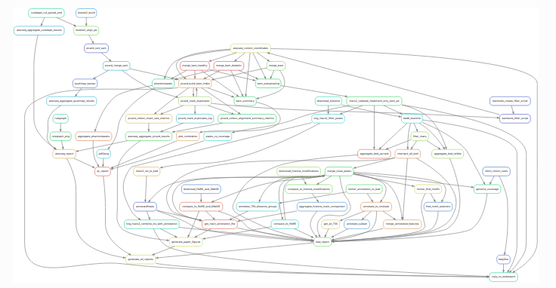
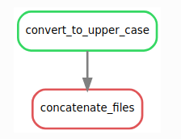
WMS advantages
Management of workflows:
Visualisations: rule-graph
Automatic up to date
Summary of the run rules
And many more…..

Slide 26
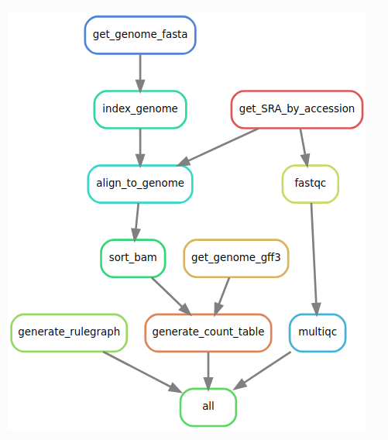
RNA-seq workflow

Slide 27
Code + Presentation

Slide 28



Notebooks
Notebooks are incredibly powerful in interactive development of code
With the possibility to share your code, results and explanations together
R-based
Python-based

Slide 29
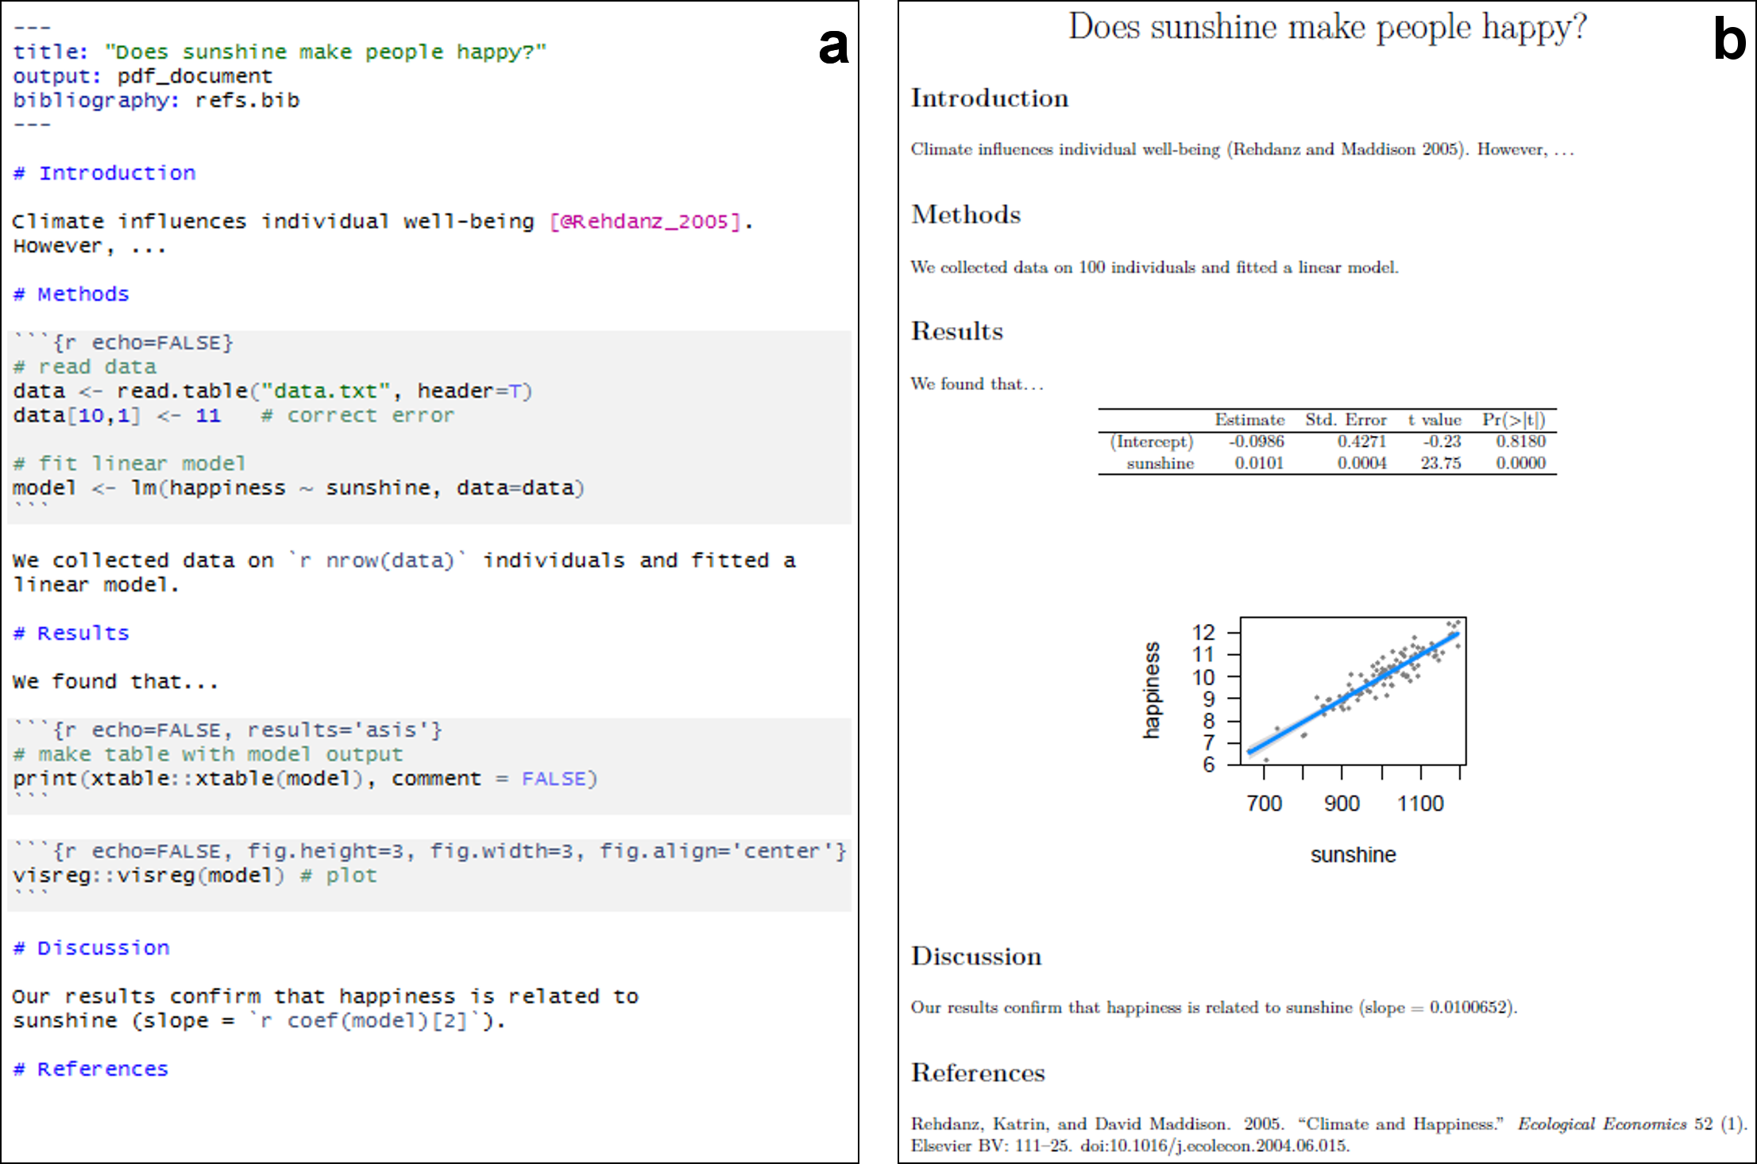
R studio and R Markdown

Slide 30
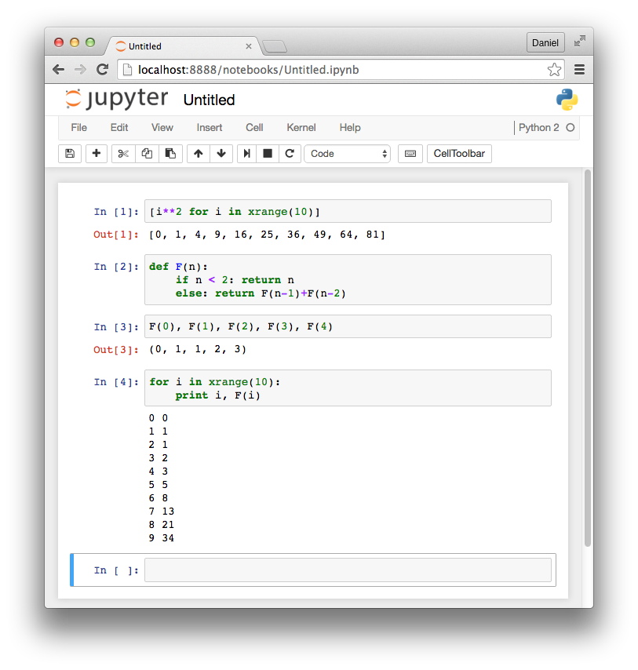
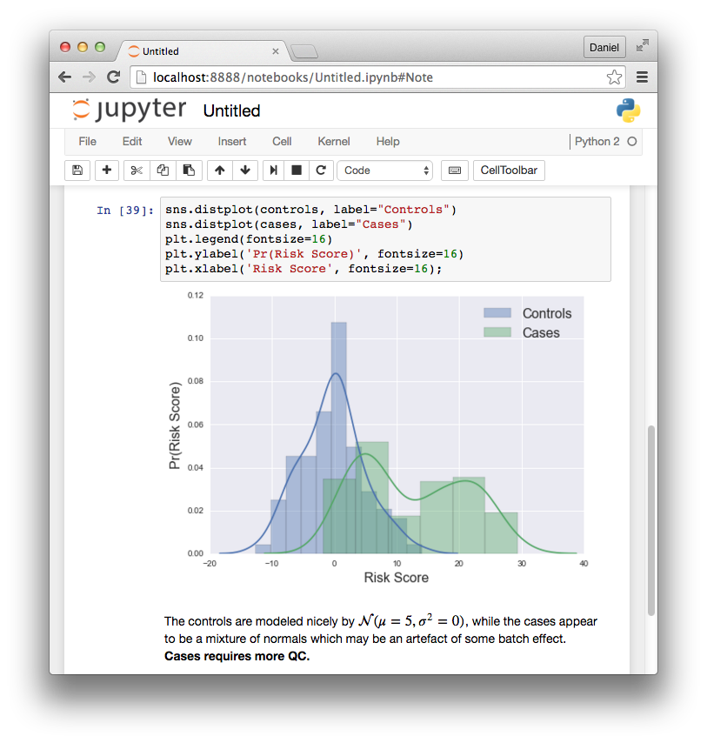
Jupyter notebook

Slide 31
Environment

Slide 32
Computational environments
Software environment
Software requires other software
e.g. DESeq2 → bioconductor → R → OS libs
Every piece of software has a version
Not all OSes have all software versions
“Must describe software and versions and their dependencies and their versions to fully recreate an environment!”
Hardware environment
Analyses are run on specific hardware
e.g. intel, AMD, GPU, SCC
Some software is hardware-specific
“Any known hardware specificities must be described to recreate an environment”
Notes:
Software requires other software

Slide 33
Environment management
Environment management = organization and configuration of a set of software
It is: a set of operations that make specific software executable
It may be: a portable description of the software environment
It is super important and helpful while working with bigger servers or clusters maintained by someone else

Slide 34

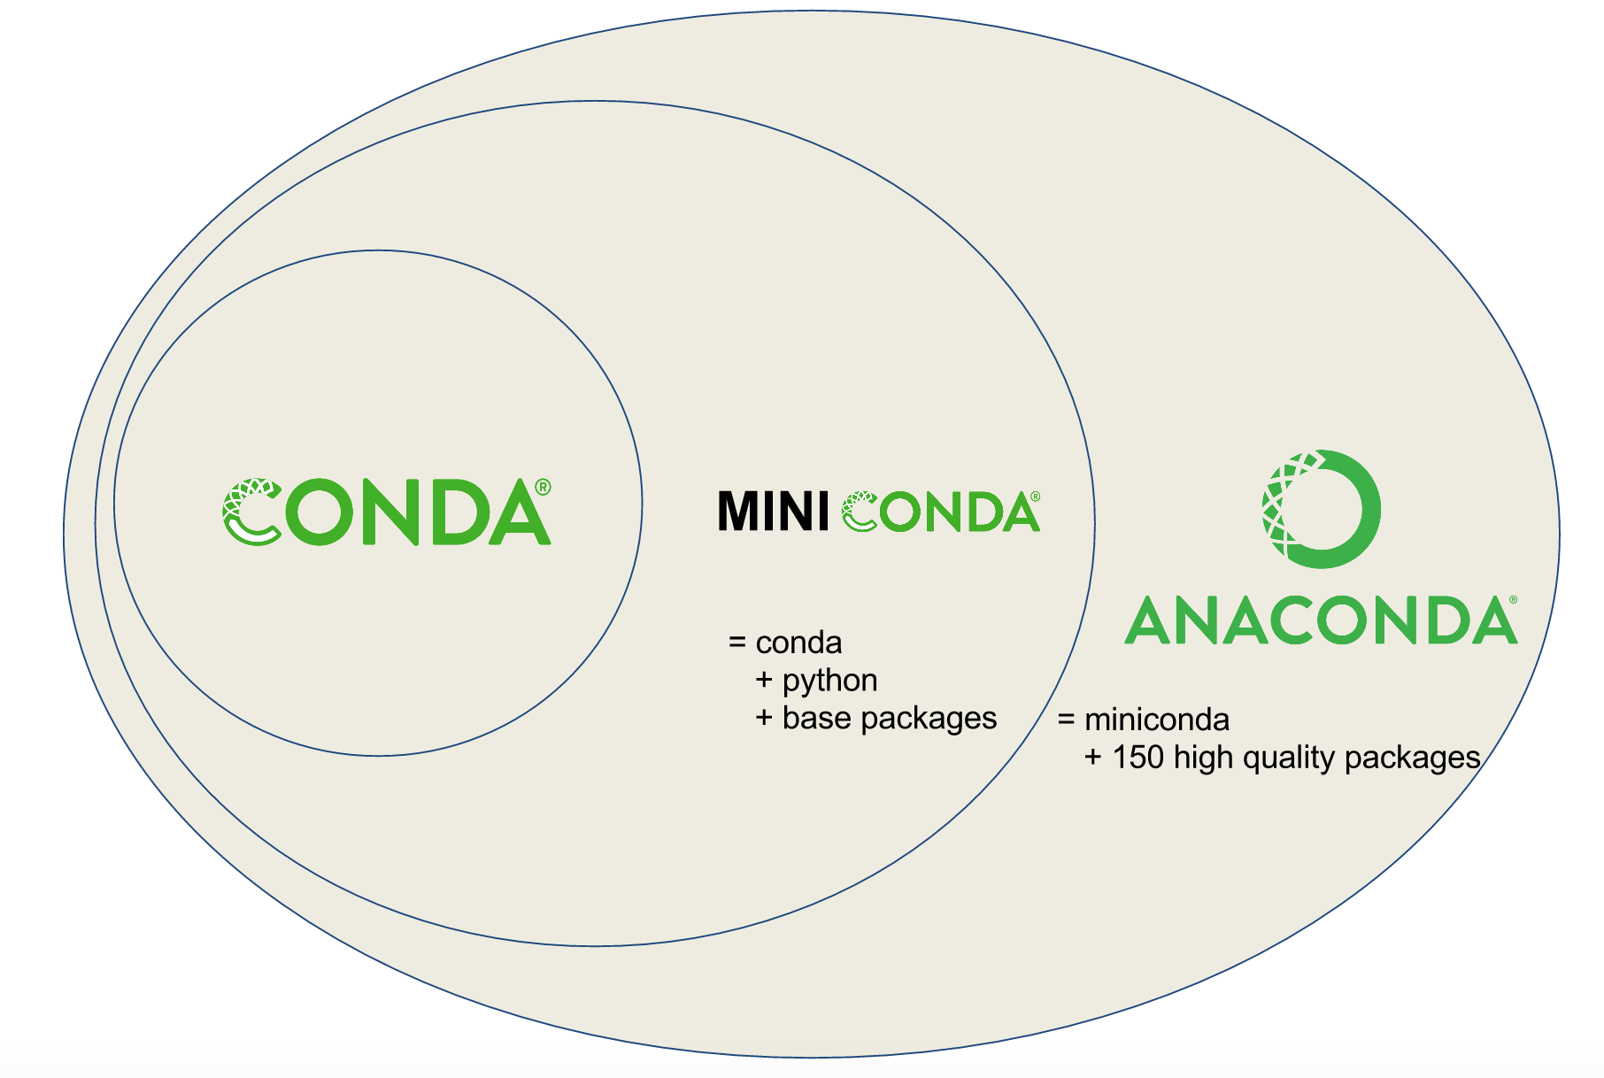
Environment manager

Slide 35
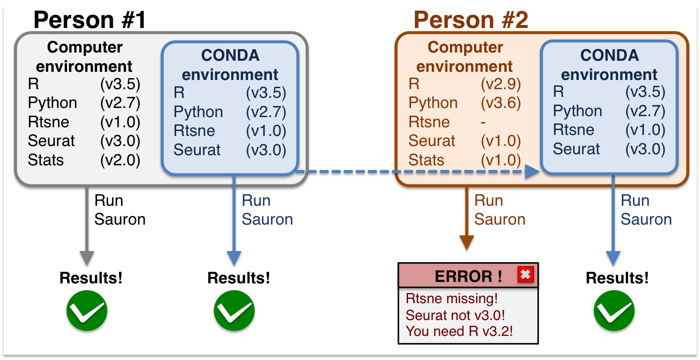
Environment manager

Slide 36
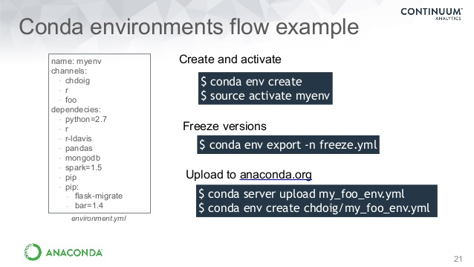
Conda environment
create environment that installs and describes a set of packages with versions
software organized into channels, e.g. bioconda
Strengths: easy to use, good environment description
Disadvantages: packages must already be in channels, when it fails it fails hard...

Slide 37


Containers
Complete environment description and isolation
Essentially mini operatings systems
Contain all specific software needed for an analysis
Custom code can also be loaded into container
Strengths: ideal strategy for encapsulating and sharing environments
Disadvantages: requires sysadmin knowhow

Slide 38
Presentation

Slide 39


Data

Slide 40
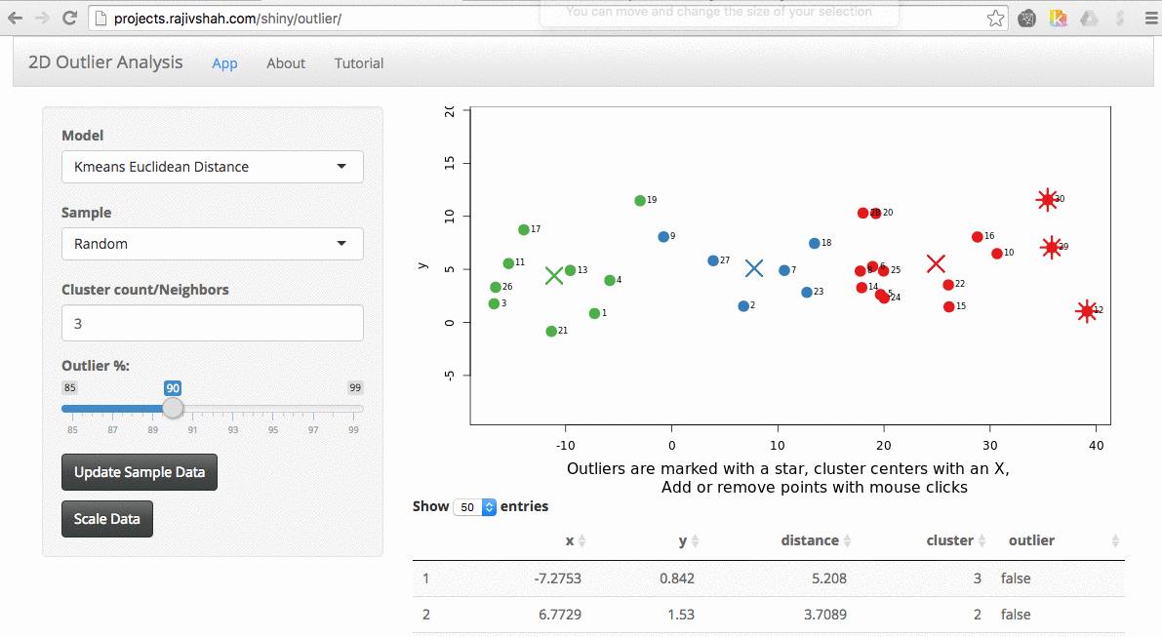
R shiny app

Slide 41
Conclusion
For Every Result, Keep Track of How It Was Produced
Avoid Manual Data Manipulation Steps
Archive the Exact Versions of All External Programs Used
Version Control All Custom Scripts
Record All Intermediate Results, When Possible in Standardized Formats
For Analyses That Include Randomness, Note Underlying Random Seeds
Always Store Raw Data behind Plots
Generate Hierarchical Analysis Output, Allowing Layers of Increasing Detail to Be Inspected
Connect Textual Statements to Underlying Results
Provide Public Access to Scripts, Runs, and Results
“Ten Simple Rules for Reproducible Computational Research” Sandve et al. (2013) PLOS Computational Biology

Slide 42
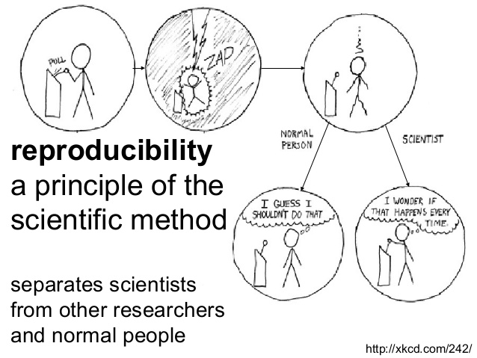
NBIS Reproducible research course
https://nbis-reproducible-research.readthedocs.io/en/latest/

